Slide 1

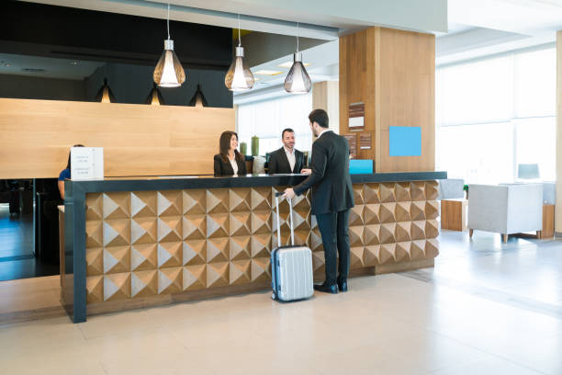

HOTEL Management SYSTEM
Submitted to:
Lt. Col IMRAN JAVED
Group members:
MUHAMMAD JAWAD LIAQAT
SHAH ZAIB SAJID

Slide 2


Introduction
As we know currently mostly Hotel Management System is using a manual file-based system for their processes.
They are keeping a huge number of files to handle guest details, bills, inventory items etc. Search for a record in the file system is harsh.
Although they are not well secured as there is a probability of getting damaged due to a fire or a tsunami or any other kind of a disaster.
This project aimed to build a fully functional computer-based system in order to achieve the efficiency in the hotel management.
The overall mission of development is to make the hotel staff quickly and easily complete the hotel management tasks.

Slide 3
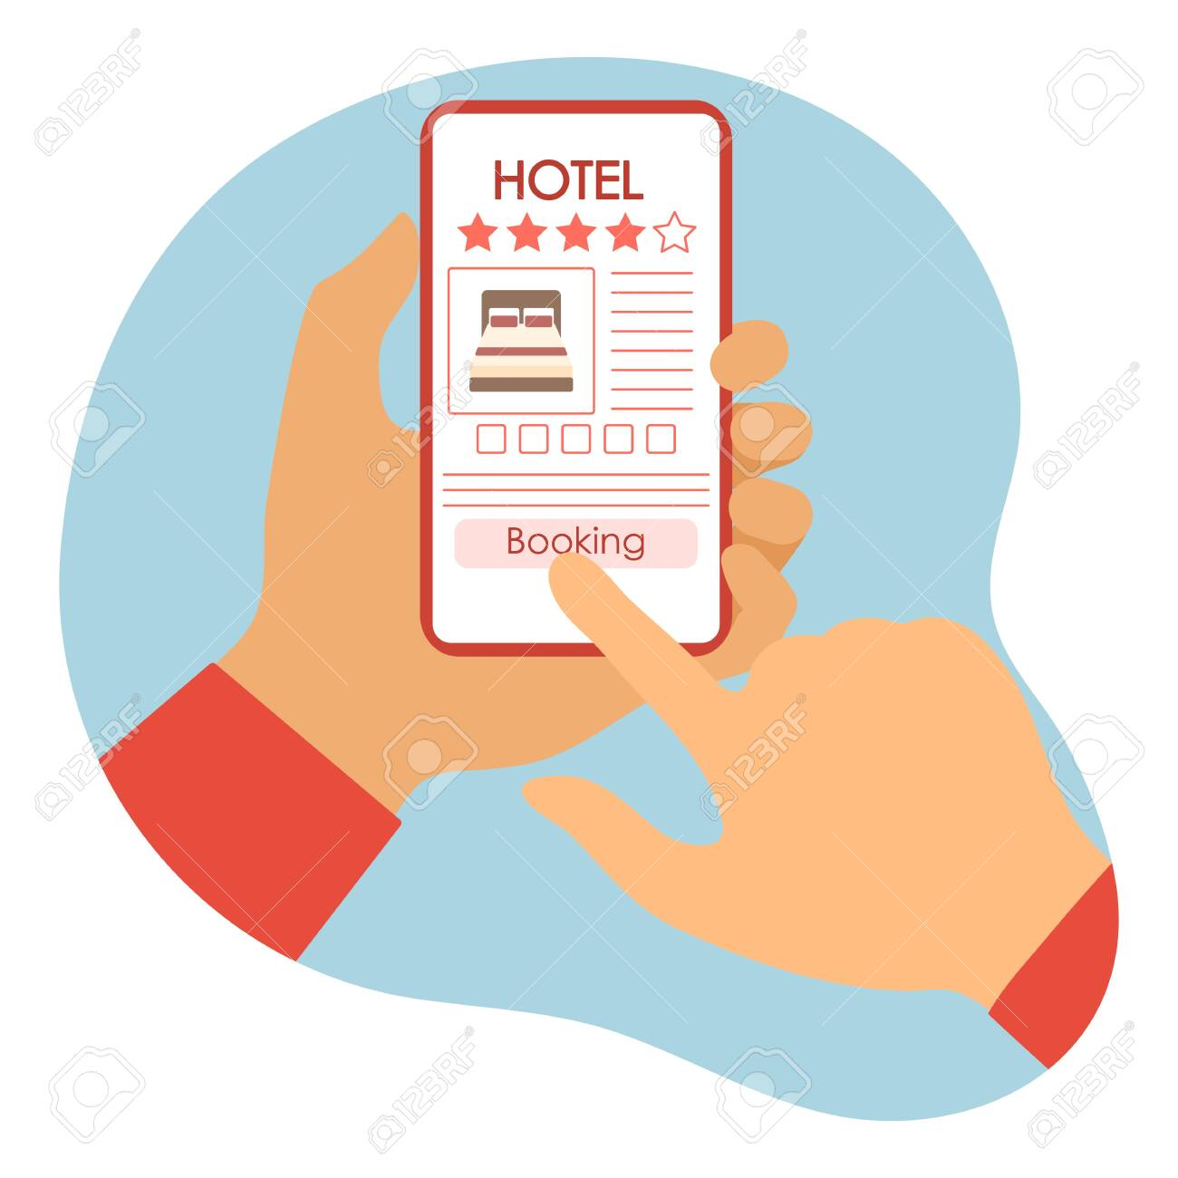
aim
The hotel management system aims to maintain and manage the various hotel tasks and processes. It is primarily responsible for hotel management in the database’s core section.
In fact, guests can come to the website and register with the system by providing the required information. Each registered guest can request unit reservations. Then the guests were given information about the availability of the units according to their request.
The application also enables the admin to operate the entire system from a single online interface. This gives the admin more power and flexibility. In addition to this, the system covers room booking, staff management, and other hotel management services.
Furthermore, the users can use the system to advertise available rooms. The customers may see and reserve rooms from the comfort of their own homes too. Then the admin has the authority to approve or reject a customer’s booking request. As a result, the system is used by both consumers and admin to control hotel activities on the go.

Slide 4
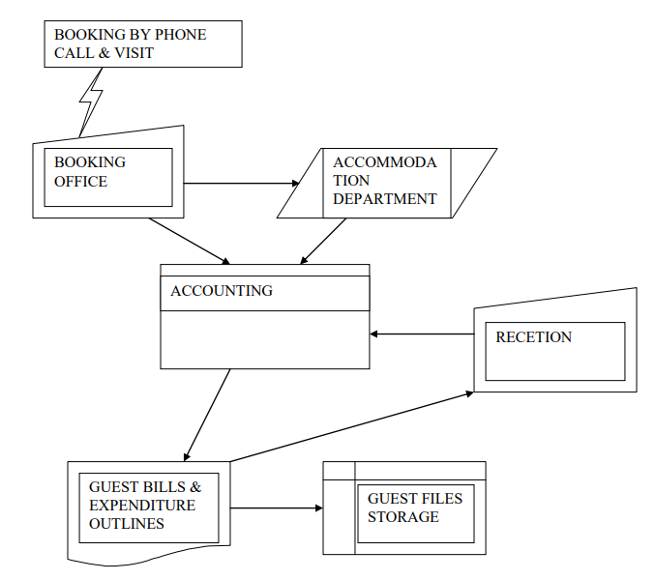


THE MANUAL SYSTEM

Slide 5
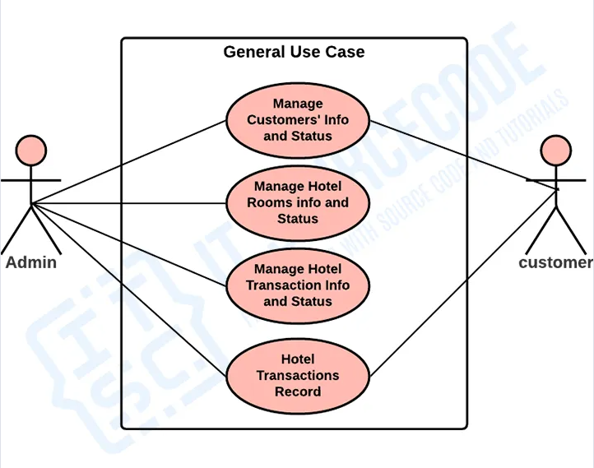
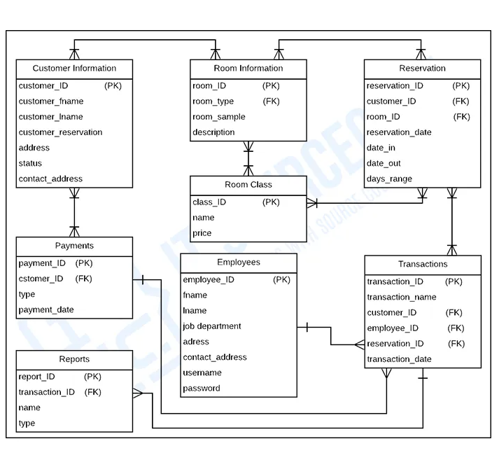
Use case diagram
VS
ER diagram

Slide 6

OBJECTIVES
A computer-based management system is designed to handle all the primary information required to calculate monthly statements. Separate database is maintained to handle all the details required for the correct statement calculation and generation. This project intends to introduce more user friendliness in the various activities such as record updating, maintenance, and searching. The searching of record has been made quite simple as all the details of the customer can be obtained by simply keying in the identification of that customer.
The record maintenance and updating can also be accomplished by using the identification of the customer with all the details being automatically generated. These details are also being promptly automatically updated in the master file thus keeping the record up to date.
The entire information has maintained in the database or Files and whoever wants to retrieve can't retrieve

Slide 7

Software Requirements
Python 3.0 (or above)
SQlite browser
Sqlite
Python IDE (VS code used)
Python libraries like Tkinter, PIL,time etc

Slide 8

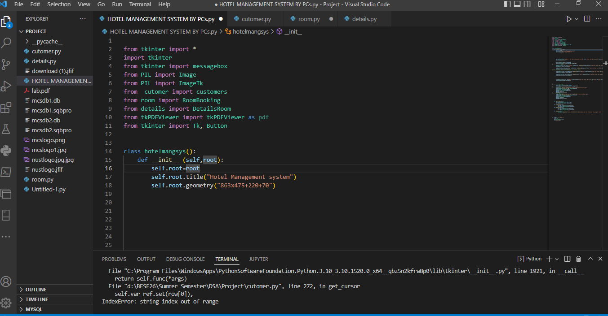
Libraries used

Slide 9
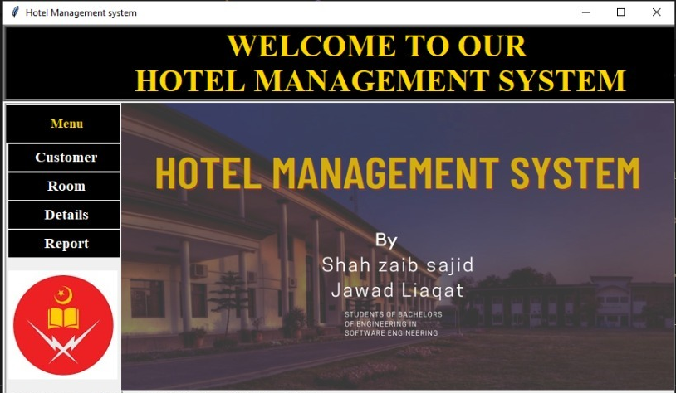
Home module
When admin opens the Application, he/she will be redirected to the home page of the app.
Various buttons i.e. Customer, Room, Details, Report are available to select from which will lead them to respective section of the application.
Also, there is a Report button which generates user manual which shows how to run the application.

Slide 10
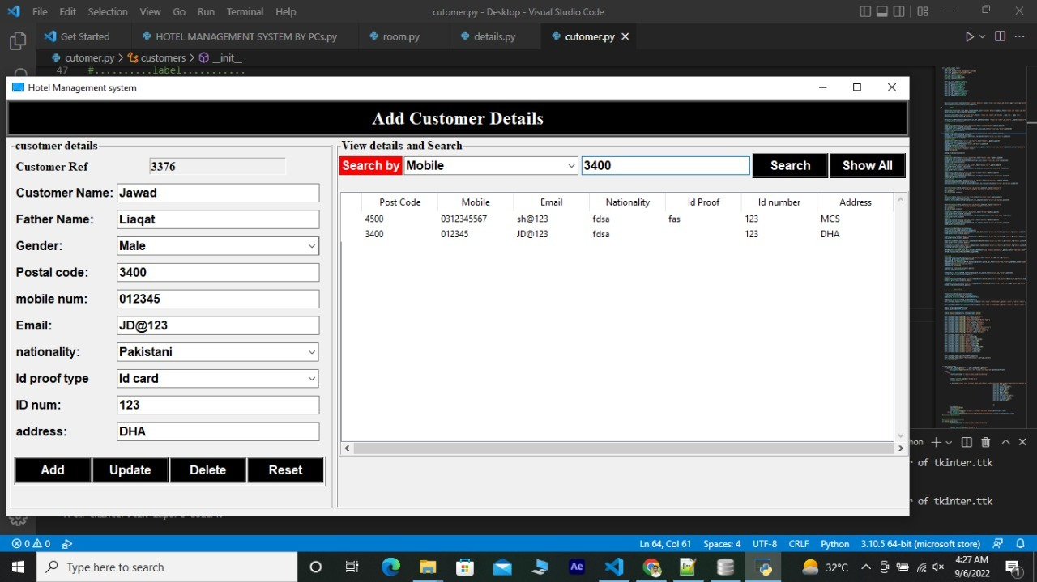
Customer module
Upon selecting Customer button from home screen, Admin will be redirected to a new tab.
Admin must enter guest’s required personal information.
Upon selecting Add button, guest’s record will be added to Hotel secured database system.
Also record of database is visible to search from along with update and delete options.

Slide 11
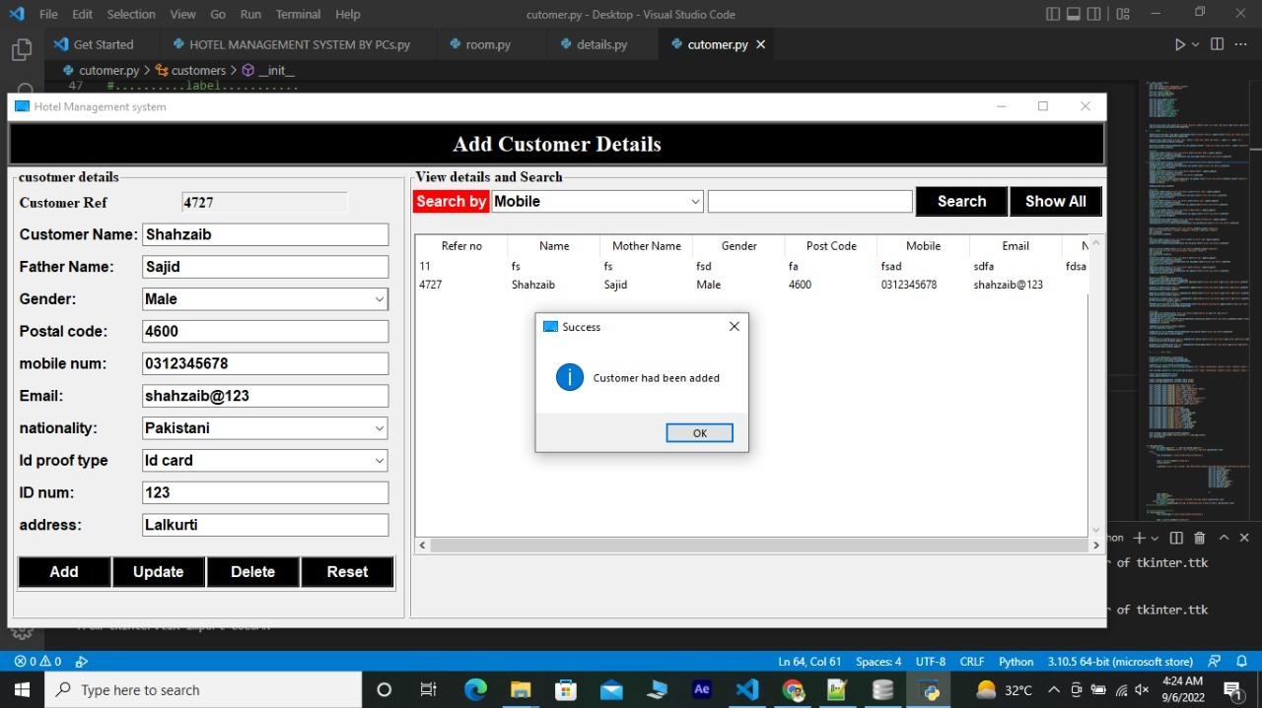
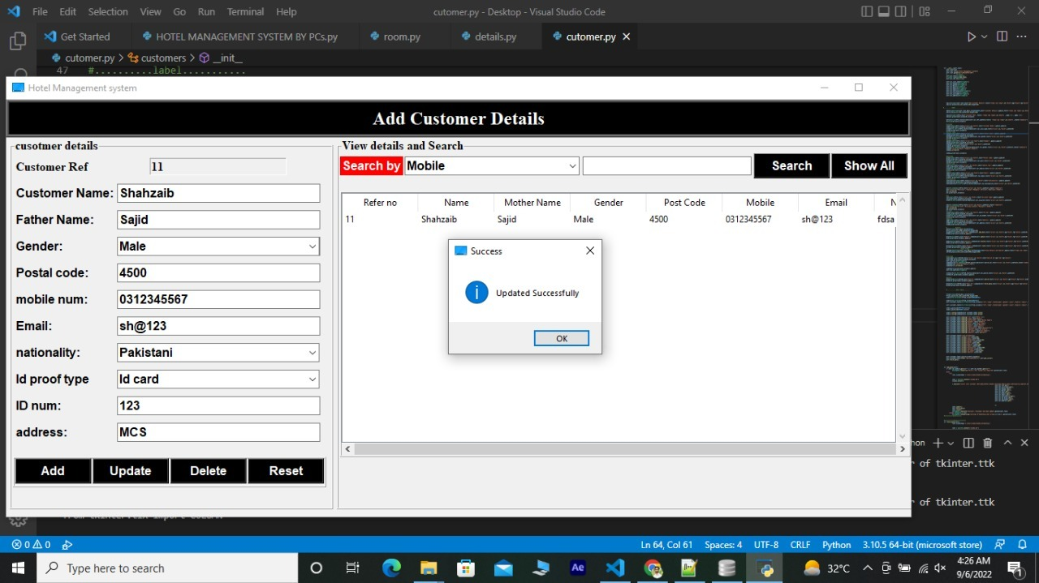
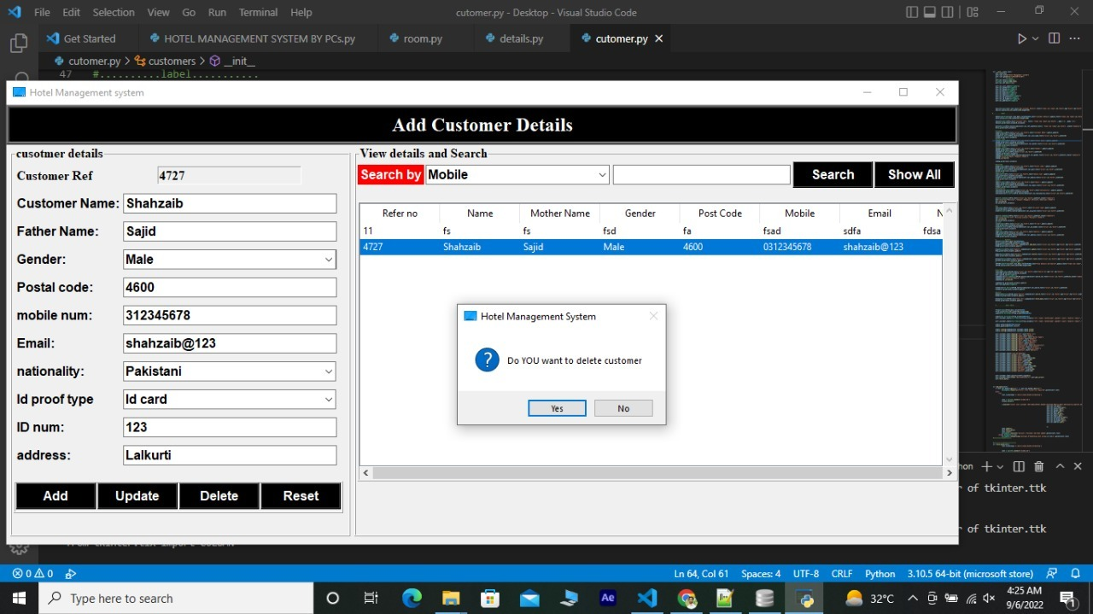
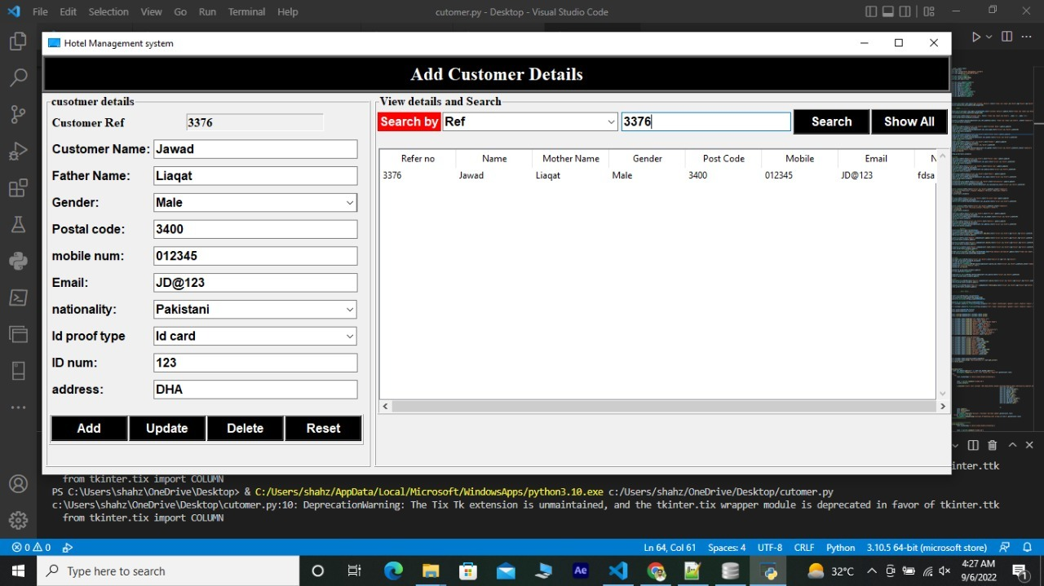

Slide 12
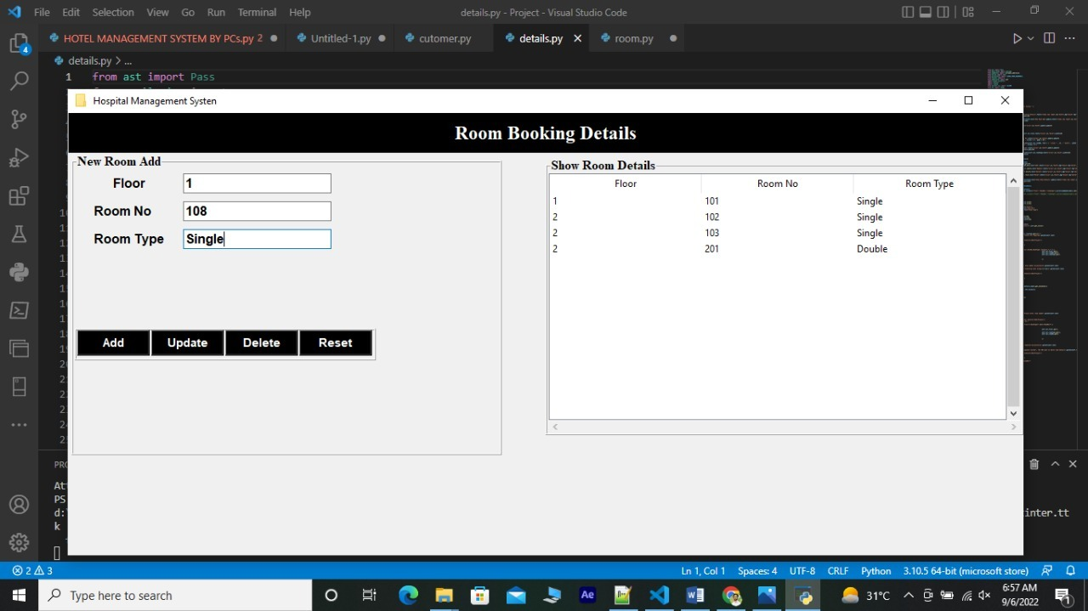
Room module
Upon selecting Room button from home screen, admin will be redirected to a new tab.
Admin must select from available room types and room numbers.
Upon selecting Add button, the record will be added to Hotel secured database system.
Also record of database is visible to search from along with update and delete options.

Slide 13
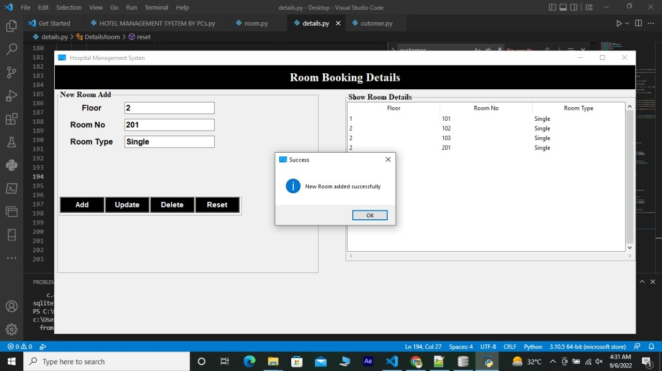
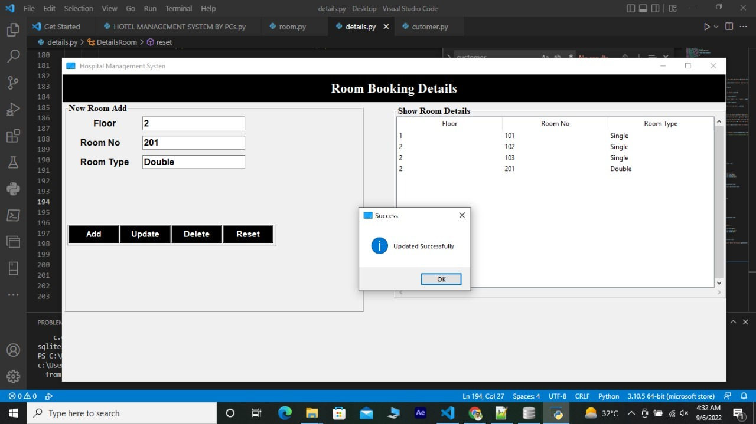
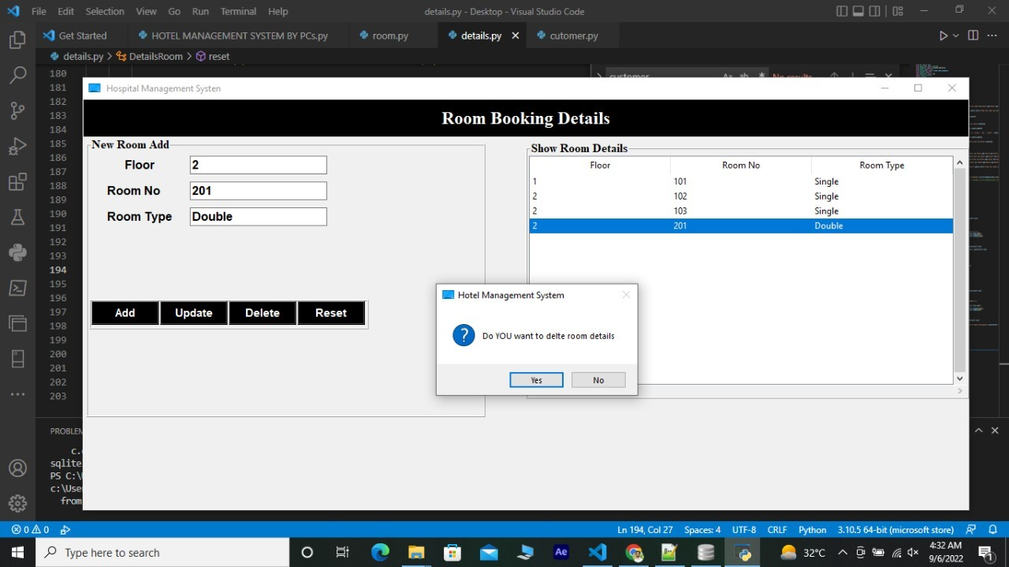
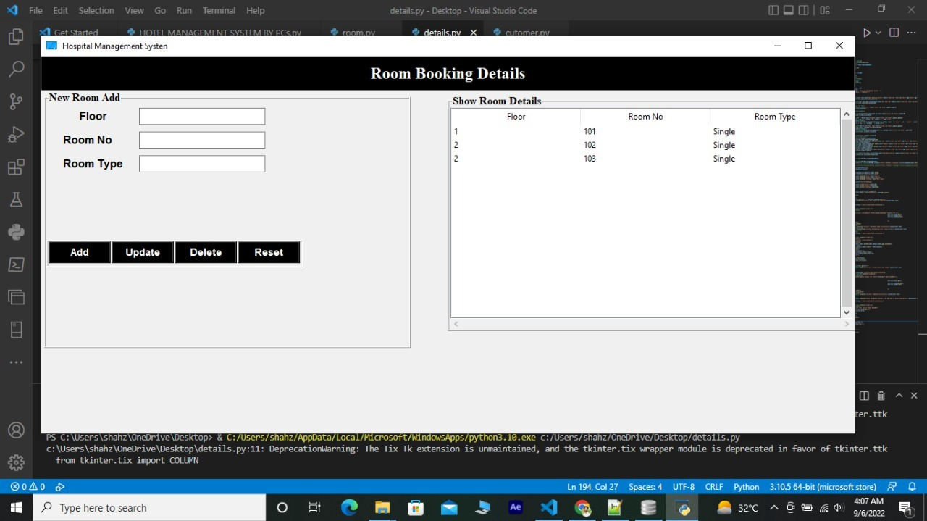

Slide 14
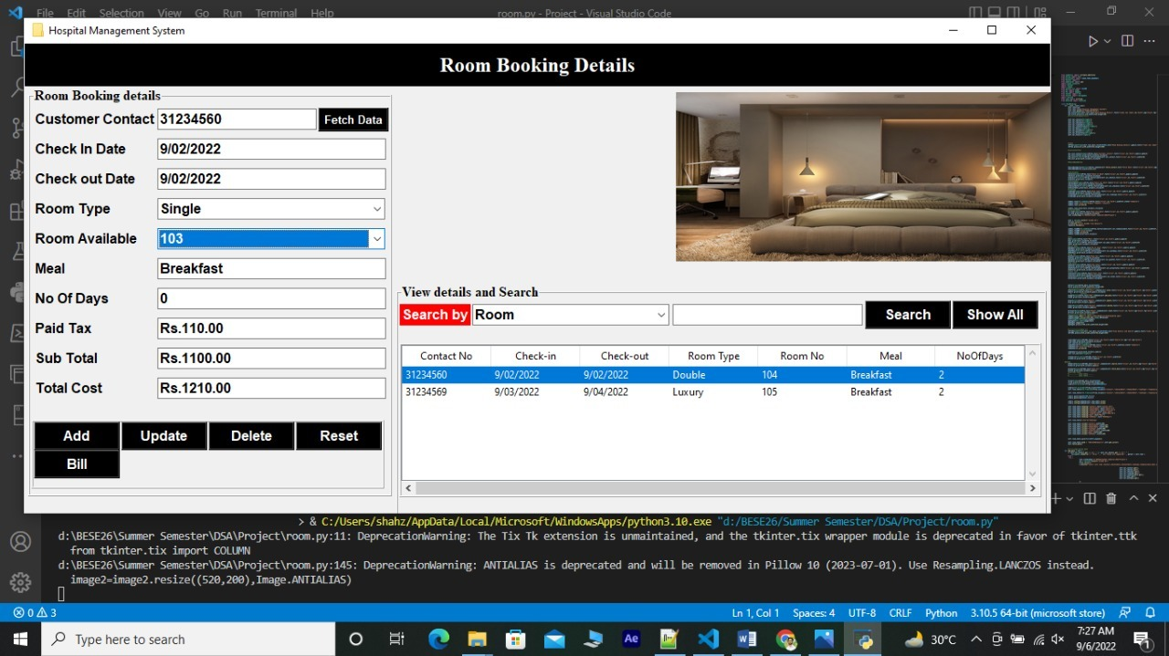
Detail module
Upon selecting Detail button from home screen, admin will be redirected to a new tab.
Admin can fetch data of guests and can update details of the room.
Also, final bill is generated here after entering check out date and other details.
Also record of database is visible to search from along with update and delete options.

Slide 15
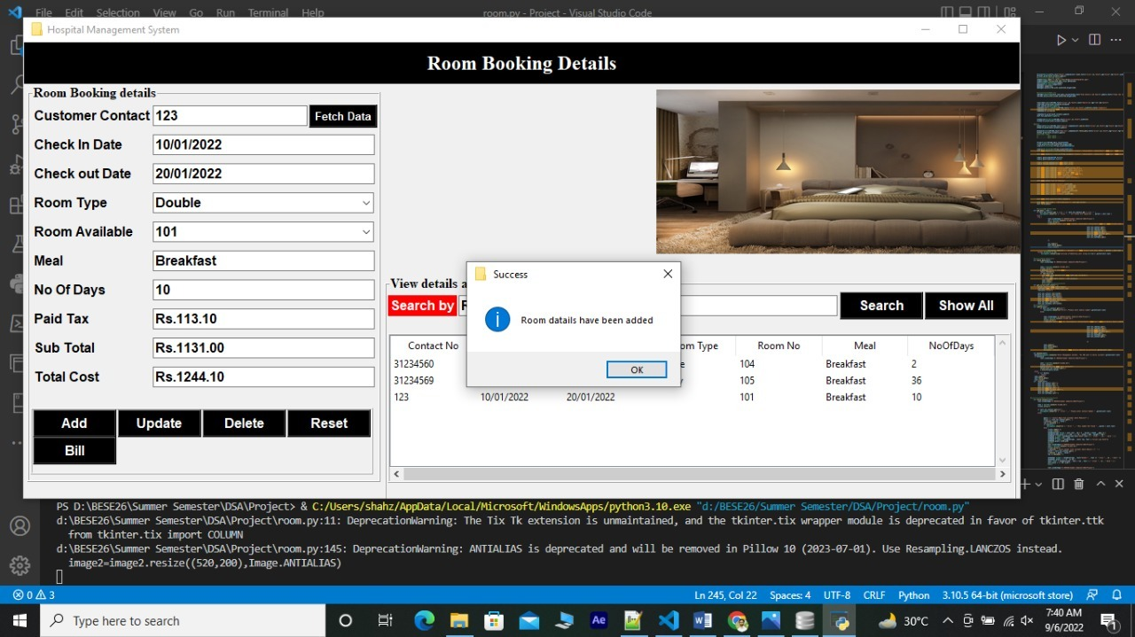
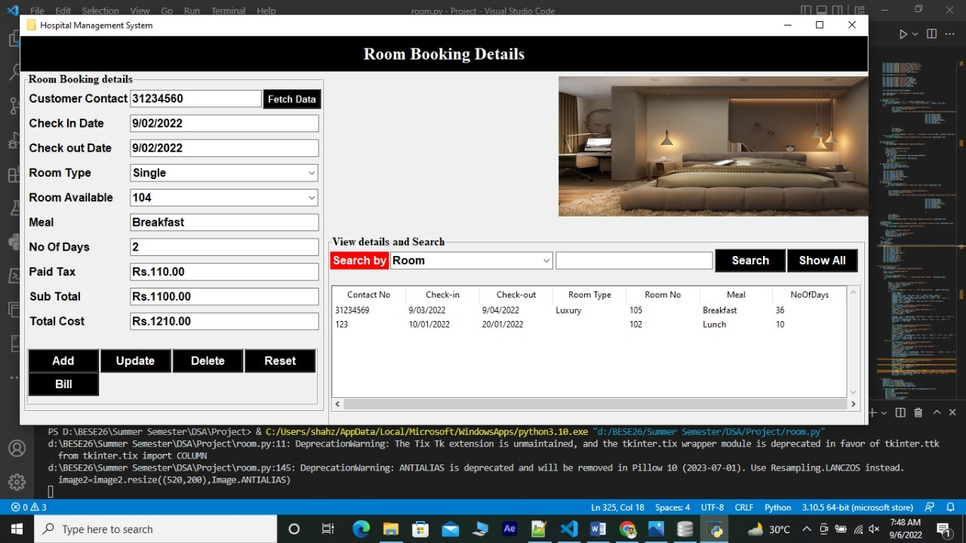
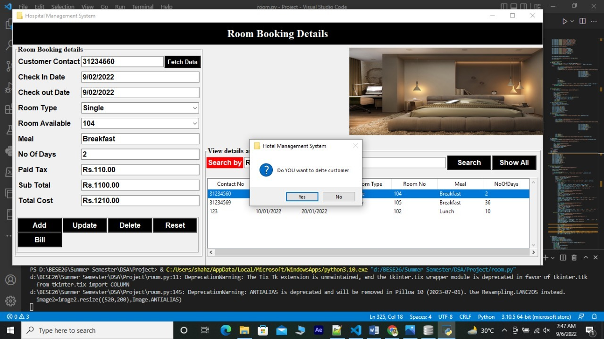
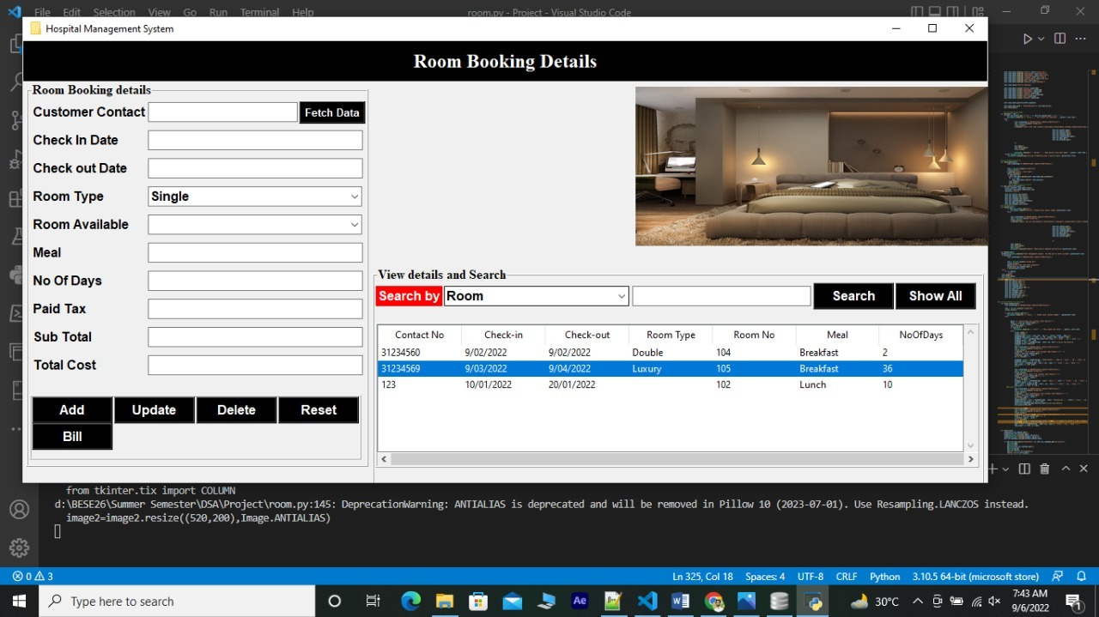

Slide 16
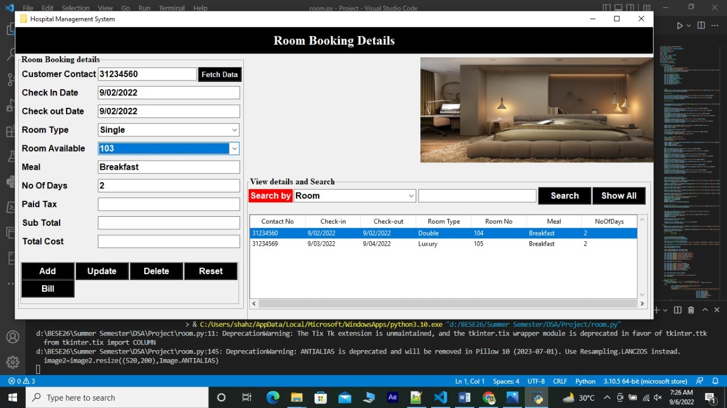
Fetching data from database
By simply selecting and clicking on already stored database, admin can automatically fetch respective data to update it.

Slide 17
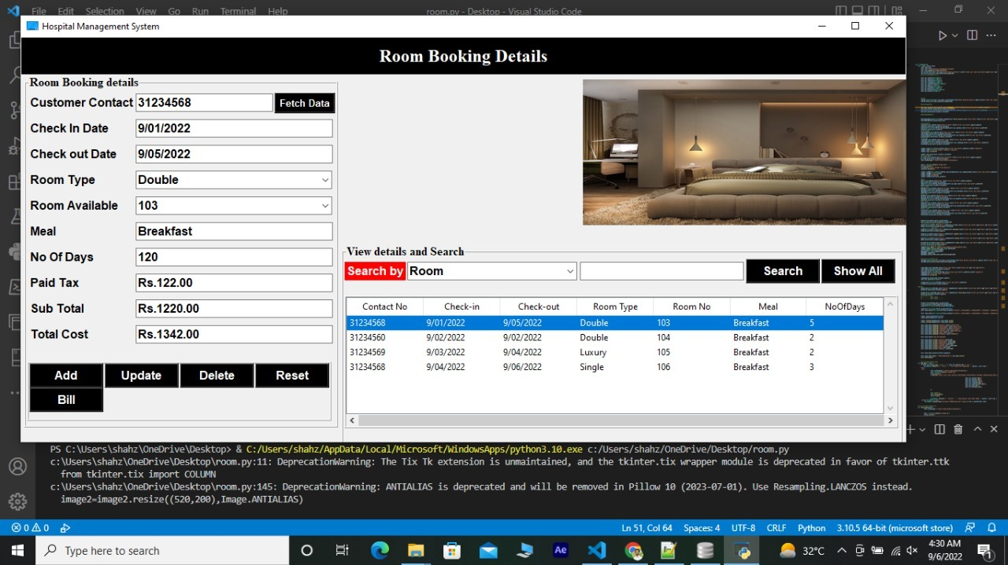
1 click Bill calculation
By simply selecting and clicking on already stored database, admin can easily calculate respective guest’s checkout bill .

Slide 18

ADVANTAGES
This management system is useful for the authorities which keep track of all the users registered in a particular state. During past several decades, the records are supposed to be manually handled for all activities. The manual handling of the record is time consuming and highly prone to error. To improve the performance of the Hotel Management System, the computerized system is to be undertaken. This project is fully computerized and user friendly even that any of the members can see the report and status of the company.
All the control is under the administrator and the other members have the rights to just see the records not to change any transaction or entry.

Slide 19
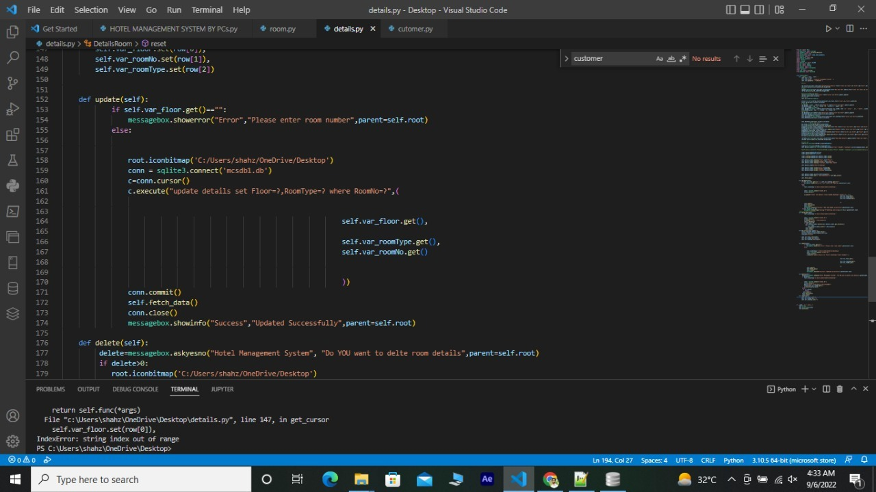
exception handling for update queries

Slide 20
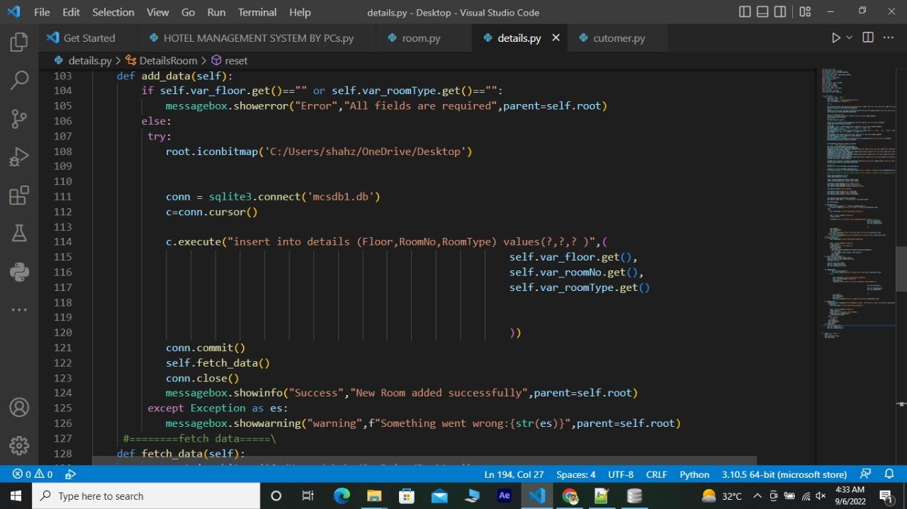
exception handling for adding data

Slide 21

Vision and future
Future updates will include more friendly GUI.
Improved security system by adding admin login via credentials.
App inbuilt services will be increased.
Launching this app on a bigger platform to not only cover nation wide hotels but also different worldwide hotels.

Slide 22

Summary
The goal of the Hotel Management System Project was to create a performing software that would aid in the maintenance of hotel users’ records. It can handle all the transactions done with the client’s information.
The overall mission of development is to make the hotel staff quickly and easily complete the hotel management tasks.
The entire information has maintained in the database

Slide 23


